Slide 1
Inheritance

Slide 2
Inheritance
Inheritance can be defined as the process where one class acquires the properties (methods and fields) of another. With the use of inheritance the information is made manageable in a hierarchical order.
class Super {
.....
.....
}
class Sub extends Super {
.....
.....
}

Slide 3
Example
class Calculation {
int z;
public void addition(int x, int y) {
z = x + y;
System.out.println("The sum of the given numbers:"+z);
}
public void Subtraction(int x, int y) {
z = x - y;
System.out.println("The difference between the given numbers:"+z);
}
}

Slide 4
Example
public class My_Calculation extends Calculation {
public void multiplication(int x, int y) {
z = x * y;
System.out.println("The product of the given numbers:"+z);
}
public static void main(String args[]) {
int a = 20, b = 10;
My_Calculation demo = new My_Calculation();
demo.addition(a, b);
demo.Subtraction(a, b);
demo.multiplication(a, b);
}
}

Slide 5
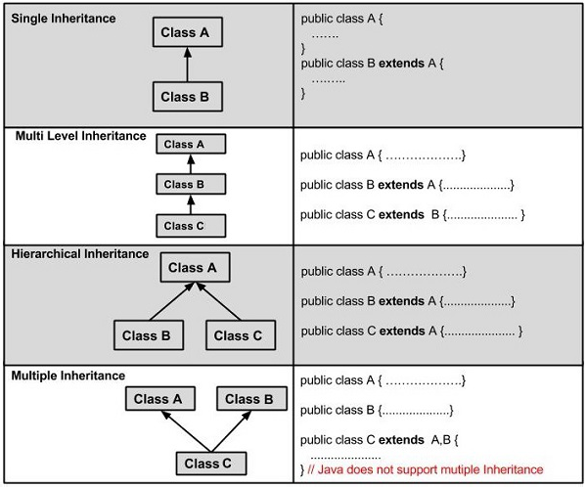
Types of inheritance

Slide 6
Inheritance example
class A {
int i, j;
void showij() {
System.out.println("i and j: " + i + " " + j);
}
}
class B extends A {
int k;
void showk() {
System.out.println("k: " + k);
}
void sum() {
System.out.println("i+j+k: " + (i+j+k));
}
}

Slide 7
Inheritance example
class SimpleInheritance {
public static void main(String args[]) {
A superOb = new A();
B subOb = new B();
superOb.i = 10;
superOb.j = 20;
System.out.println("Contents of superOb: ");
superOb.showij();
System.out.println();
subOb.i = 7;
subOb.j = 8;
subOb.k = 9;
System.out.println("Contents of subOb: ");
subOb.showij();
subOb.showk();
System.out.println();
System.out.println("Sum of i, j and k in subOb:");
subOb.sum();
}
}

Slide 8
output
Contents of superOb:
i and j: 10 20
Contents of subOb:
i and j: 7 8
k: 9
Sum of i, j and k in subOb:
i+j+k: 24

Slide 9
Member access
Subclass includes all of the members of its superclass, it cannot access those members of the superclass that have been declared as private
Box program (Refer PDF)

Slide 10
Using Super
The super keyword in Java is a reference variable which is used to refer immediate parent class object.
super can be used to refer immediate parent class instance variable.
super can be used to invoke immediate parent class method.
super() can be used to invoke immediate parent class constructor.

Slide 11
Example
class BoxWeight extends Box {
double weight; // weight of box
// initialize width, height, and depth using super()
BoxWeight(double w, double h, double d, double m) {
super(w, h, d); // call superclass constructor
weight = m;
}
}
Super box program (Refer PDF)

Slide 12
Example for super.member
super.member
Here, member can be either a method or an instance variable.
class A {
int i;
}
class B extends A {
int i; // this i hides the i in A
B(int a, int b) {
super.i = a; // i in A
i = b; // i in B
}
void show() {
System.out.println("i in superclass: " + super.i);
System.out.println("i in subclass: " + i);
}
}
class UseSuper {
public static void main(String args[]) {
B subOb = new B(1, 2);
subOb.show();
}
}
This program displays the following:
i in superclass: 1
i in subclass: 2

Slide 13
Multilevel
Consider three classes called A, B, and C, C can be a subclass of B, which is a subclass of A.
When this type of situation occurs, each subclass inherits all of the traits found in all of its superclasses. In this case, C inherits all aspects of B and A.
Example
BoxWeight is used as a superclass to create the subclass called Shipment.
Shipment inherits all of the traits of BoxWeight and Box, and adds a field called cost, which holds the cost of shipping such a parcel.

Slide 14
Constructors in Inheritance
In a class hierarchy, constructors are called in order of derivation, from superclass to subclass.
super( ) must be the first statement executed in a subclass’ constructor.
This order is the same whether or not super( ) is used.
If super( ) is not used, then the default or parameterless constructor of each superclass will be executed.

Slide 15
Constructors in Inheritance Example
class A {
A() {
System.out.println("Inside A's constructor.");
}
}
class B extends A {
B() {
System.out.println("Inside B's constructor.");
}
}
class C extends B {
C() {
System.out.println("Inside C's constructor.");
}
}
class CallingCons {
public static void main(String args[]) {
C c = new C();
}
}
Output:
Inside A’s constructor
Inside B’s constructor
Inside C’s constructor

